Slide 1

Depi
01
Event management

Slide 2
Depi
02
About the Project
_"In today's fast-paced world, managing events efficiently has become more challenging than ever. Organizers struggle with juggling tasks like registration, ticketing, communication, and ensuring smooth operations on the day of the event. Traditional methods, such as spreadsheets and manual registration processes, are not only time-consuming but also prone to errors.

Slide 3

Depi
03
About the Strategy
That's where our Event Management System comes in. Built using the powerful Laravel framework, this system streamlines the entire event lifecycle—from creation to registration, ticketing, and real-time tracking. Whether it's a small conference, a large expo, or a community gathering, our platform is designed to make event management simple, efficient, and stress-free for organizers and participants alike.

Slide 4
Depi
05
Meet Our Team
mostafa ibrahim
Ahmed Hamdy

Slide 5
Depi
06
Our Professional Services
Book tickets
Make Like On Event
Save Events
Create Event

Slide 6

Depi
08
Benefit of the Project
Automation
Scalability:
Security
Efficiency.
Customizability

Slide 7
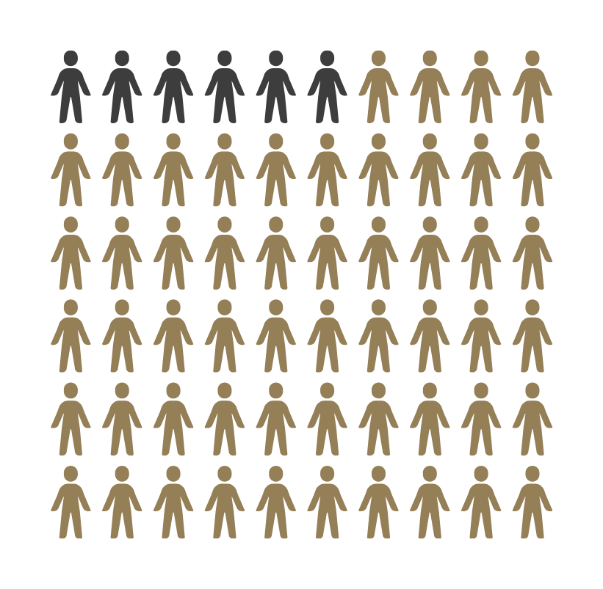
Depi
09
Target Audience
We Target Yonge People to use this Website

Slide 8
Depi
10
Thank you!

